Slide 1
CT004-3.5-3
Advanced Database Systems
Database Security

Slide 2
Objectives
Scope of database security.
Why database security is a serious concern for an organization.
Type of threats that can affect a database system.
DISCRETIONARY ACCESS CONTROL (SQL security)

Slide 3
Database Security
Mechanisms that protect the database against intentional or accidental threats.

Slide 4
Database Security
Data is a valuable resource that must be strictly controlled and managed, as with any corporate resource.
Part or all of the corporate data may have strategic importance and therefore needs to be kept secure and confidential.
Security considerations do not only apply to the data held in a database. Breaches of security may affect other parts of the system, which may in turn affect the database.

Slide 5
Database Security
Involves measures to avoid:
  Theft and fraud
  Loss of confidentiality (secrecy)
  Loss of privacy
  Loss of integrity
  Loss of availability
Notes:
542 | Chapter 19 z Security
19.1
In Section 19.1 we discuss the scope of database security and examine the types of threat
that may affect computer systems in general. In Section 19.2 we consider the range of
computer-based controls that are available as countermeasures to these threats. In Sec-
tions 19.3 and 19.4 we describe the security measures provided by Microsoft Ofﬁce
Access 2003 DBMS and Oracle9i DBMS. In Section 19.5 we identify the security
measures associated with DBMSs and the Web. The examples used throughout this chapter
are taken from the DreamHome case study described in Section 10.4 and Appendix A.
Database Security
In this section we describe the scope of database security and discuss why organizations
must take potential threats to their computer systems seriously. We also identify the range
of threats and their consequences on computer systems.
Database The mechanisms that protect the database against intentional or acci-
security dental threats.
Security considerations apply not only to the data held in a database: breaches of
security may affect other parts of the system, which may in turn affect the database.
Consequently, database security encompasses hardware, software, people, and data. To
effectively implement security requires appropriate controls, which are deﬁned in speciﬁc
mission objectives for the system. This need for security, while often having been
neglected or overlooked in the past, is now increasingly recognized by organizations. The
reason for this turnaround is the increasing amounts of crucial corporate data being stored
on computer and the acceptance that any loss or unavailability of this data could prove to
be disastrous.
A database represents an essential corporate resource that should be properly secured
using appropriate controls. We consider database security in relation to the following
situations:
n theft and fraud;
n loss of conﬁdentiality (secrecy);
n loss of privacy;
n loss of integrity;
n loss of availability.
These situations broadly represent areas in which the organization should seek to reduce
risk, that is the possibility of incurring loss or damage. In some situations, these areas are
closely related such that an activity that leads to loss in one area may also lead to loss in
another. In addition, events such as fraud or loss of privacy may arise because of either
intentional or unintentional acts, and do not necessarily result in any detectable changes to
the database or the computer system.
Theft and fraud affect not only the database environment but also the entire organiza-
tion. As it is people who perpetrate such activities, attention should focus on reducing the
opportunities for this occurring. Theft and fraud do not necessarily alter data, as is the case
for activities that result in either loss of conﬁdentiality or loss of privacy.
Conﬁdentiality refers to the need to maintain secrecy over data, usually only that which
is critical to the organization, whereas privacy refers to the need to protect data about in-
dividuals. Breaches of security resulting in loss of conﬁdentiality could, for instance, lead
to loss of competitiveness, and loss of privacy could lead to legal action being taken
against the organization.
Loss of data integrity results in invalid or corrupted data, which may seriously affect the
operation of an organization. Many organizations are now seeking virtually continuous
operation, the so-called 24/7 availability (that is, 24 hours a day, 7 days a week). Loss
of availability means that the data, or the system, or both cannot be accessed, which can
seriously affect an organization’s ﬁnancial performance. In some cases, events that cause
a system to be unavailable may also cause data corruption.
Database security aims to minimize losses caused by anticipated events in a cost-
effective manner without unduly constraining the users. In recent times, computer-based
criminal activities have signiﬁcantly increased and are forecast to continue to rise over the next few years

Slide 6
Threat
  Any situation or event, whether intentional or unintentional, that will negatively affect a system and consequently an organization.

Slide 7
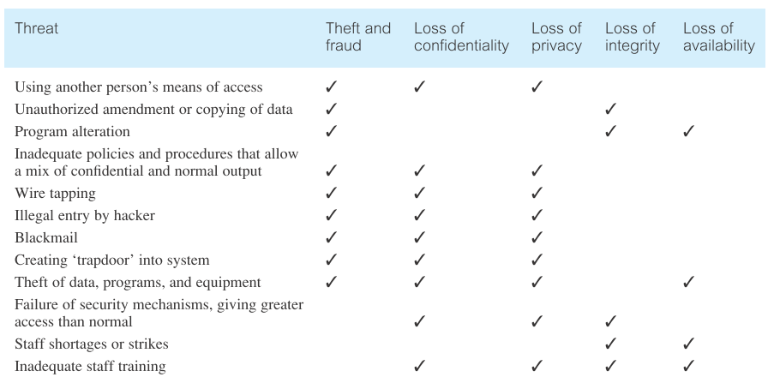
List of threats and there effects

Slide 8
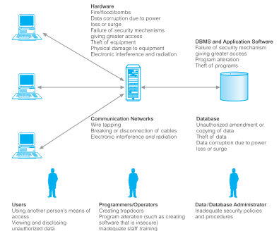
Threats summary

Slide 9
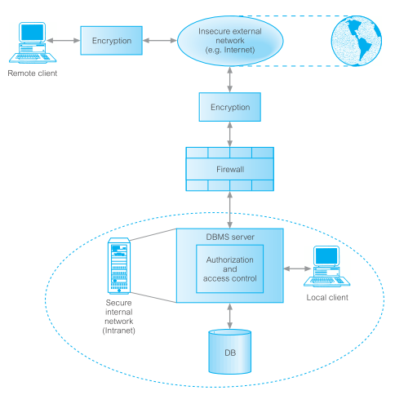
Representation of a typical multi-user computer environment.
SQL security
DISCRETIONARY ACCESS CONTROL

Slide 10
Authorization & Authentication
Authorization: The granting of a right or privilege that enables a user to have legitimate access to a system or a system’s object.
Authentication: A mechanism that determines whether a user is who he or she claims to be.

Slide 11
Database Security
Authorization Rules Authentication Access
Requests
DBA
Database Security
System
Database
Users
Database

Slide 12
Database Security
Three main issues in DB Security:
1. Legal and Ethical considerations: who has the right to read what information?
2. Policy issues: Who should enforce security (government, corporations, department)?
3. System level issues: where should security be enforced in the System and How?

Slide 13
Database Security
ACCESS CONTROL
Who should be allowed access to which databases.
Typically enforced using system level accounts with passwords.

Slide 14
DISCRETIONARY ACCESS CONTROL
Authorization rules take into accounts a THREE concepts:
1. Users: Individuals who perform some activity on the database.
2. Objects: Database units that require authorization in order to manipulate, eg. Table, columns, and rows.
3. Privileges: Any action that might be performed on an object by a user. Eg. Read, update, Insert, Delete.
Notes:
SQL security is centered around three concepts or ideas:
❑ Users: Users, or more correctly user IDs, represent people or programs performing actions on
objects in the database. Whenever the DBMS creates a new table, inserts or deletes records in
that table, or modifies the records in that table, it does so on behalf of a user ID. The DBMS
grants user IDs privileges to perform specific actions on specific tables.
❑ Objects: The SQL standards define specific objects in the database that users can manipulate.
Originally the only objects were tables and views, but the standard has been expanded to
include specific columns in tables as well as domains and character sets, and the individual
DBMS often adds its own objects that it allows users to manipulate.
❑ Privileges: The third leg of SQL security comprises privileges that allow users to manipulate
objects. These privileges start with SELECT, INSERT, DELETE, and UPDATE for tables and views
but have been expanded to include privileges appropriate to non-data objects.

Slide 15
authorization table
USER | OBJECT | Privilege
Ed | Employee | Read
Ed | Employee | Insert
Ed | Employee | Modify
Ed | Employee | Grant
Bill | Employee | Read
Sally | Purchase Order | Insert
Sally | Purchase Order | Modify
Clerks | Employee | Read

Slide 16
DISCRETIONARY ACCESS CONTROL
User-Based Security
Users are individually defined in the DBMS and each object and Privilege is specified.
Eg . User SMITH
 | Objects
Privileges | Employees | Orders | Products | ……..
Read | Y | Y | Y | ….
Insert | N | Y | N | ….
Modify | N | Y | Y | ….
Delete | N | N | N | ….
Grant | N | N | N | ….

Slide 17
DISCRETIONARY ACCESS CONTROL
Object Based Security
Objects are individually defined in the DBMS and each subject and action is specified.
Eg. The EMPLOYEES table has the following authorizations:
 | Users
Privilege | SMITH | JONES | GREEN | DBA | …..
Read | Y | Y | N | Y | …
Insert | N | N | N | Y | …
Modify | N | N | N | Y | …
Delete | N | N | N | Y | …
Grant | N | N | N | Y | …

Slide 18
GRANT and REVOKE Statements
SQL provides two main statements for setting up authorization.
GRANT is used to grant an action on an object to a user.
GRANT action1, action2,…..
ON object1, object2, …..
TO subject1, subject2, ….
Another option of the GRANT Statement is WITH GRANT OPTION. This allows grantee to propagate the authorization to another subject.
Eg. A database with
Tables: employees, departments, orders, products.
Users: Smith, Jones, Green, Dba.
GRANT INSERT, DELETE, UPDATE, SELECT ON employees, departments TO Smith;

Slide 19
GRANT and REVOKE Statements
GRANT INSERT, SELECT ON orders To Smith;
GRANT SELECT ON products To Smith;
GRANT SELECT
ON employees, departments To Jones;
GRANT INSERT, DELETE, UPDATE,
SELECT ON employees, departments, orders,
products To DBA
WITH GRANT OPTION;
Grants can also be done on specific columns in a table:
GRANT SELECT ON products To Jones;
GRANT UPDATE ON products (price) to Jones;
If no GRANT statement is issued, it is assumed that no authorization is given (eg. User Green).

Slide 20
GRANT and REVOKE Statements
REVOKE is used to revoke authorization from Subjects.
REVOKE action1, action2, ….
ON object1, object2, ….
FROM subject1, subject2, ….
If Smith leaves the company, then we should REVOKE INSERT, DELETE, UPDATE, SELECT ON employees, departments FROM Smith;
  REVOKE INSERT, SELECT ON orders FROM Smith;
REVOKE SELECT ON products FROM Smith;
Many RDBMS have all PRIVILEGES option that will revoke all of the privileges on an object from a Subject.
REVOKE ALL PRIVILEGES ON employees, departments, orders, products FROM Smith;

Slide 21
Q & A

